Slide 1
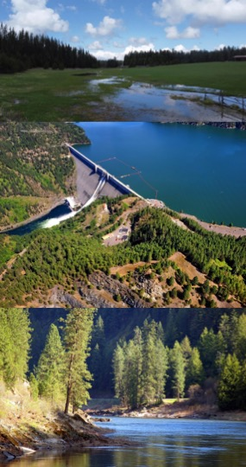

Water Quality Modeling Workflow using CE-QUAL-W2
Todd Steissberg, PhD, PE
Environmental Laboratory
U.S. Army Engineer Research and Development Center (ERDC)
January 22, 2025

Slide 2
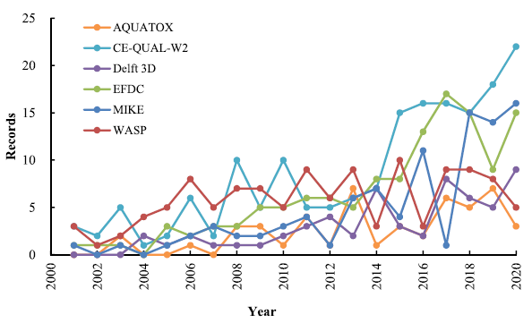
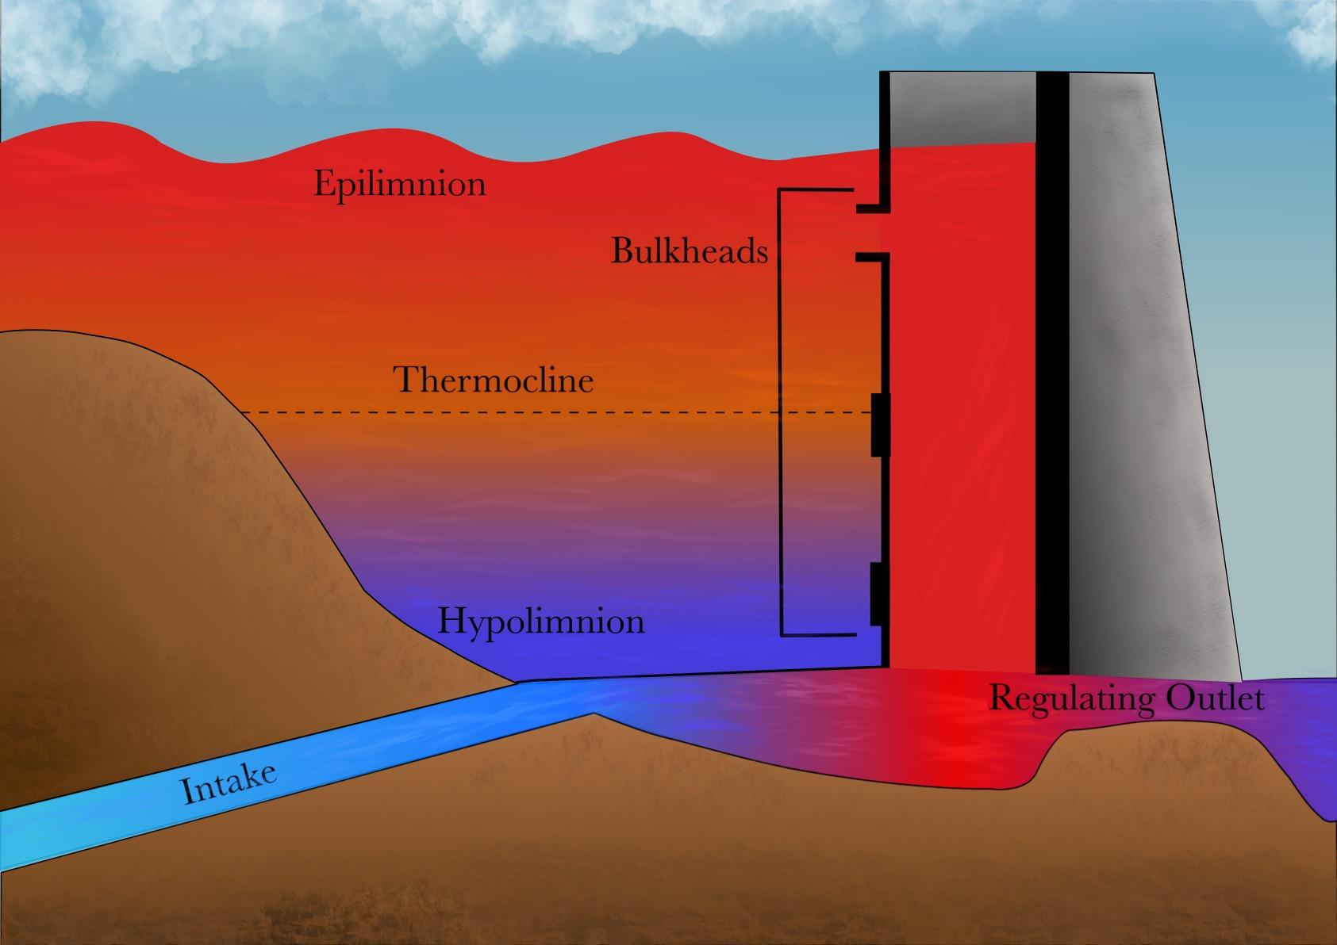
CE-QUAL-W2
CE‐QUAL‐W2 (W2) is a two‐dimensional (2D), longitudinal/vertical, hydrodynamics and water quality model that enables characterization of vertical and longitudinal changes in reservoirs.
The model assumes reservoirs are well mixed laterally, with no variation from one channel side to the other in a layer (vertical) and segment (longitudinal).
CE-QUAL-W2 has been applied to rivers, lakes, reservoirs, and estuaries.
Ecological Modelling 466 (2022) 109888

Slide 3
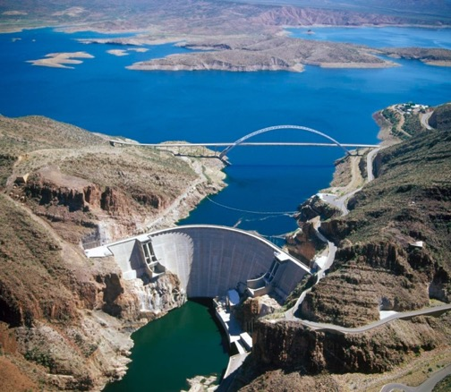
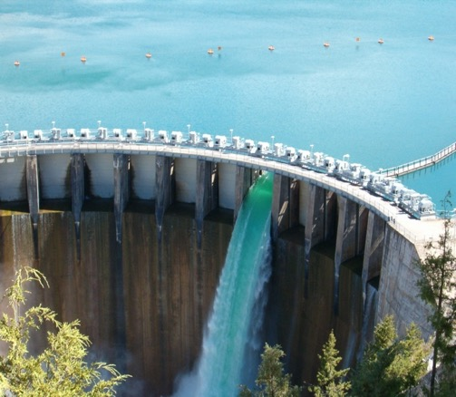
CE-QUAL-W2 Capabilities
Longitudinal-vertical hydrodynamics and water quality in stratified and non-stratified systems
Nutrients-dissolved oxygen-organic matter interactions
Fish habitat
Selective withdrawal from stratified reservoir outlets
Hypolimnetic aeration
Multiple algae, epiphyton/periphyton, zooplankton, and macrophytes
Carbonaceous Biochemical Oxygen Demand (CBOD)
Sediment diagenesis model
Generic water quality groups
Hydraulic structures (weirs, spillways, pipes, culverts) algorithms, including a dynamic shading algorithm based on topographic and vegetative cover.
Water age – Useful for forensic analyses

Slide 4
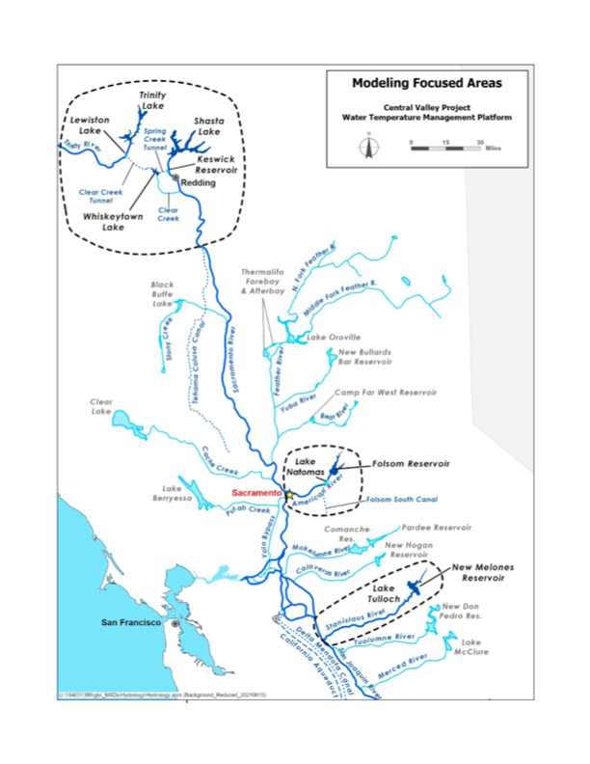
Past and Current Applications of CE-QUAL-W2
CE-QUAL-W2 is widely used by the U.S. Army Corps of Engineers (USACE) and other U.S. federal, state, and local agencies for environmental impact assessments, planning studies, etc. Agencies that use CE-QUAL-W2 as their standard reservoir water quality model include:
U.S. Geological Survey (USGS)
U.S. Bureau of Reclamation
U.S. Environmental Protection Agency (EPA)
State of California
More than 1,100 model applications have been developed worldwide for reservoirs, rivers, estuaries, and other water bodies since CE-QUAL-W2 was released in 1986.
CE-QUAL-W2 is also used as a research tool by researchers at universities and other organizations.
At least 1,500 publications utilized or cited CE-QUAL-W2 in the year 2022 alone.
Recent Studies:
Water Temperature Modeling Platform, California Central Valley Project (USBR and State of California): This platform applies CE-QUAL-W2 for ongoing and future operations decision-making
USACE Northwest Division, Columbia and Snake River Watershed
Columbia System Reservoir Operation (CRSO) Project
Columbia River Treaty (CRT) Project
Philadelphia District, Lehigh River Water Quality Modeling
Region of Application:
Water Temperature Modeling Platform
California Central Valley Project

Slide 5
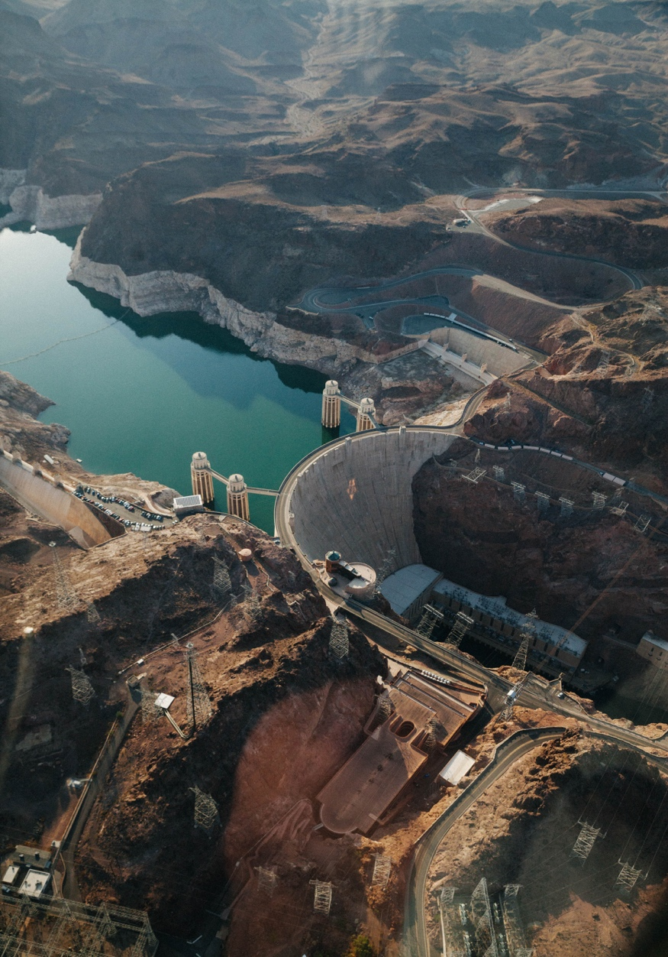
CE-QUAL-W2 Benefits
Since it was first released in 1986, CE-QUAL-W2 has been used by water quality managers to assess impacts of management strategies on reservoir, lake, and estuarine systems.
CE-QUAL-W2 computes the two-dimensional velocity field for narrow systems that stratify.
In contrast with reservoir models with simplified hydrodynamics, CE-QUAL-W2 accurately simulates vertical and longitudinal transport of constituents, which can be as important as chemical kinetics in accurately simulating water quality.
Applications of CE-QUAL-W2 include:
Planning Studies
Environmental Impact Assessments
Ecosystem Restoration Projects
Real-Time Systems Operation and Decision-Making

Slide 6
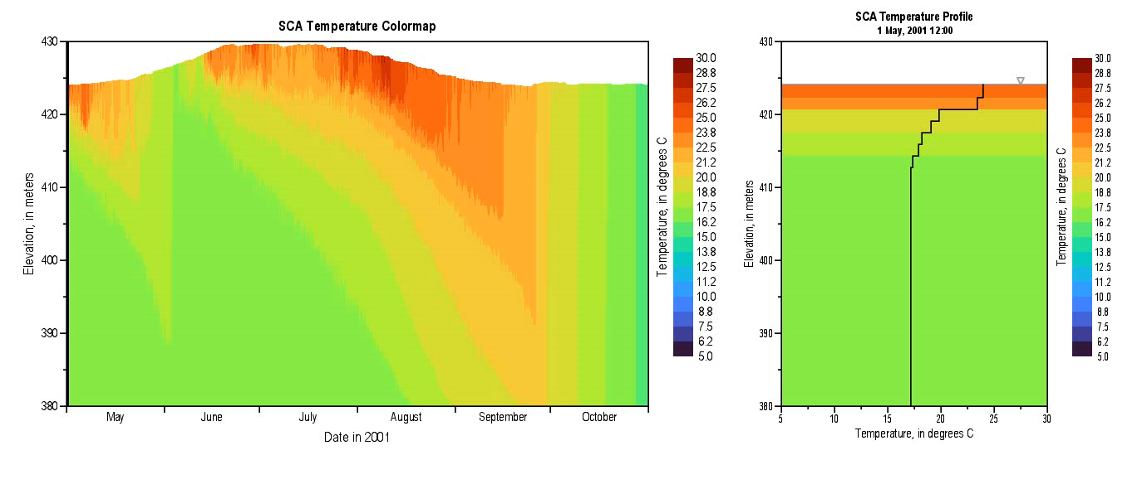
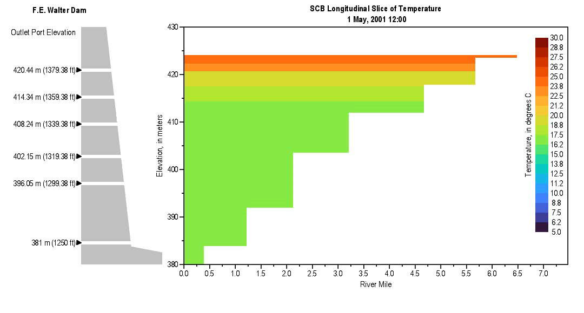
Modeling Workflow
Project Initiation (Objectives and Data)
Initial and Boundary Conditions and Parameters
Model Grid (Bathymetry & Connectivity)
Model Calibration and Validation
Scenario Analysis
Reporting and Decision Support
Model Refinement and Maintenance
Sensitivity Analysis

Slide 7
Modeling Workflow
Project Initiation
Define study objectives
Data collection (bathymetry, hydrology, structural, temperature, water quality, meteorology, operations)
Data QA/QC
Gap filling
Model Grid (bathymetry grid and segment connectivity)
Initial and Boundary Conditions and Parameters
Create time series files (CSV)
Set parameters (e.g., algal respiration rates) in control file (Excel with macros)
Model Calibration and Validation (compare modeled vs. observed)
Hydrodynamics
Temperature
Water Quality Constituents
Sensitivity Analysis
Scenario Analysis (Alternatives Analysis)
Evaluate effects of changes to operations, flows, meteorology (climate), and loadings (pollution)
Reporting and Decision Support
Model Refinement and Maintenance

Slide 8
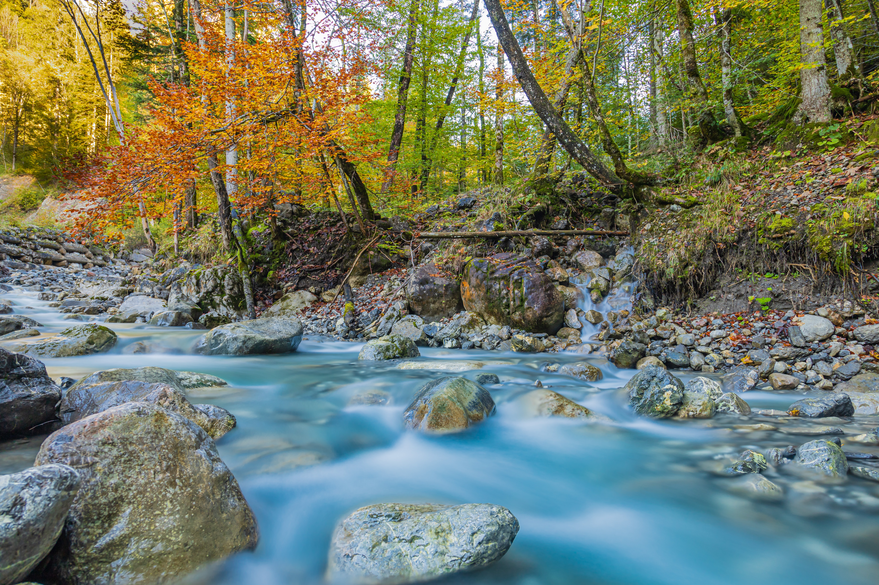
Questions?

